Slide 1



Crash Course: Azure Resource Manager
Wely Lau
SR Cloud Solution Architect
Microsoft APAC
ADITYO SETYONUGROHO
AZURE RANGER
Microsoft INDONESIA
Notes:
Hey folks, Wely here. It’s been a while since we published the video series of implementing multi-region deployment and DR in Azure.
In this video, I’ll provide a crash course about ARM Azure Resource Manager. This provides a fundamental to understand the next video on deploying the actual solution.
Thanks to Adit which contributes to this crash course. Let's get started.

Slide 2
Infrastructure as Code and Azure Resource Manager
Infrastructure as Code: mechanism to define your infrastructure setup in code.
Benefits: Creation automation, faster deployment, and reduce errors.
Azure Resource Manager (ARM) is the native Infrastructure as Code (IoC) from Azure which enables you to deploy and manage Azure resources in very modular way.
Benefits of ARM:
Deploy, manage, and monitor all of the resources for your solution as a group.
Redeploy your solution throughout the development lifecycle.
Manage your infrastructure through templates rather than scripts.
Administrator defined dependencies.
Apply access control to all services in your resource group.
Notes:
Before talking about the ARM, I wanna take a step back to explain Infrastructure as Code (IoC), which I believe many of you have heard.
IoC is the mechanism which allow you to define your infrastructure setup in code. The main idea are to enable automation and faster deployment. It also could reduce the human error.
ARM is the native IoC from Azure, which allow you to deploy and managed Azure resources in very modular way.
With ARM, you can deploy, manage, or delete your resources as a group. It enables you to redeploy your solution much easier through the development lifecycle.
You can define the dependency of your template as well as applying access control to your resource group.

Slide 3
Azure Resource Groups
Management – deploy, update, delete and get status on all resources in a resource group from a single point.
Flexibility - some resources can be moved between resource groups.
Portability - resource groups can be exported to templates for easier redeployment.
Billing – a bill can be retrieved on a per resource group basis.
Access Control – Permissions can be applied on a per resource group basis.
RESOU
R
CE G
R
OUP
Notes:
The are several concepts which I need to cover to ensure that we are aligned. The first one is Azure Resource Group. Think about RG as a logical grouping of your resources. You can manage all resources in a RG from a single point. You can also export the template of an RG for enable easier deployment.

Slide 4
Azure Resource Providers
A resource provider is a service that supplies the resources that you deploy and manage through Azure Resource Manager.
Each resource provider offers a set of operations for working with a particular resource type.
Resource providers have different regional availability and apiVersions.
PowerShell
Get-AzureLocation
Get-AzureRmResourceProvider
Get-AzResourceProvider (newer Az Module)
Example of Resource Provider Types
Resource Type | Usage
Microsoft.Compute/virtualMachines | Virtual Machines
Microsoft.Storage/storageAccounts | Storage Accounts
Microsoft.Compute/availabilitySets | Availability Sets
Microsoft.Network/networkInterfaces | Virtual Network Interface Card (NIC)
Microsoft.Network/loadBalancers | Azure Load Balancer or Internal Load Balancer
Microsoft.Network/virtualNetworks | Virtual networks
Microsoft.ClassicStorage | ASM Storage
Microsoft.ClassicCompute | ASM Virtual Machines
Complete list of Resource Provider can be found:
https://docs.microsoft.com/en-us/azure/azure-resource-manager/management/azure-services-resource-providers
Notes:
Resource Provider is a services that supplies the resources when you deploy thru ARM. Each RP offers a set of operation of particular Azure services. Here are some examples of RP. You can browse more details RP in the following link.

Slide 5
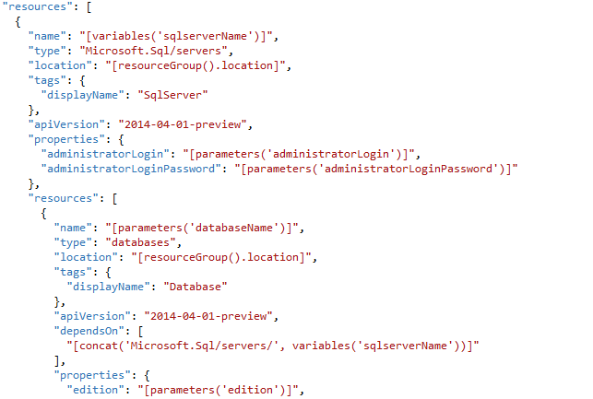
JSON Template
Declarative programming
Structure elements
Parameters
Variables
Resources
Outputs
Notes:
ARM are implemented with JSON as the template.
It is a declarative model, which means you tell the ARM engine here’s the final state that I expect, let the ARM engine figure out the how it should deploy. You don’t have to tell the ARM engine what to do in step by step.
Typically there are 4 sections in ARM: Parameters, Variables, Resources, Outputs

Slide 6
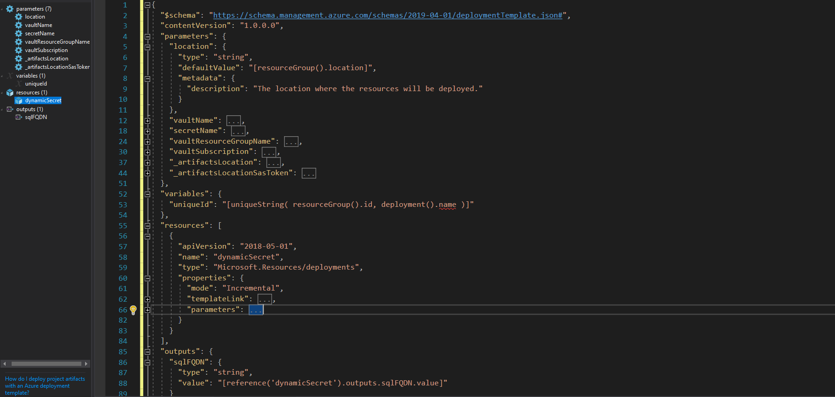
Parameters – user input for the template
Variables – allows model reuse and “mappings”
Resources – models all the resources in the resource group
Outputs – captures information from the execution
Notes:
Let’s take a deeper look in one of the ARM example.
First, it’s the parameter. These are the value which we expect from user input. As can be seen, I defined the several parameters here. Each parameter will have type, default value, and other metadata such as description.
Second, variables. It allow us to reuse the values throughout our ARM script.
Third, resources. This is the most important section, where you define what resources to be created in the deployment.
Fourth, output. Optionally you may need to capture information as part of the execution, for example FQDN or IP address of certain resources.

Slide 7
Getting started with the ARM Template
Browse from existing gallery
Exporting your Template from Azure Portal
Create a new one
Notes:
Ok, we’ve covered the basic concept. Now let’s move on to the next section, how to get started ARM Template.
There are typically 3 ways: firstly, create an entirely new ARM template,
Second: is to browse from existing gallery,
Third, export the template from your existing resource.

Slide 8
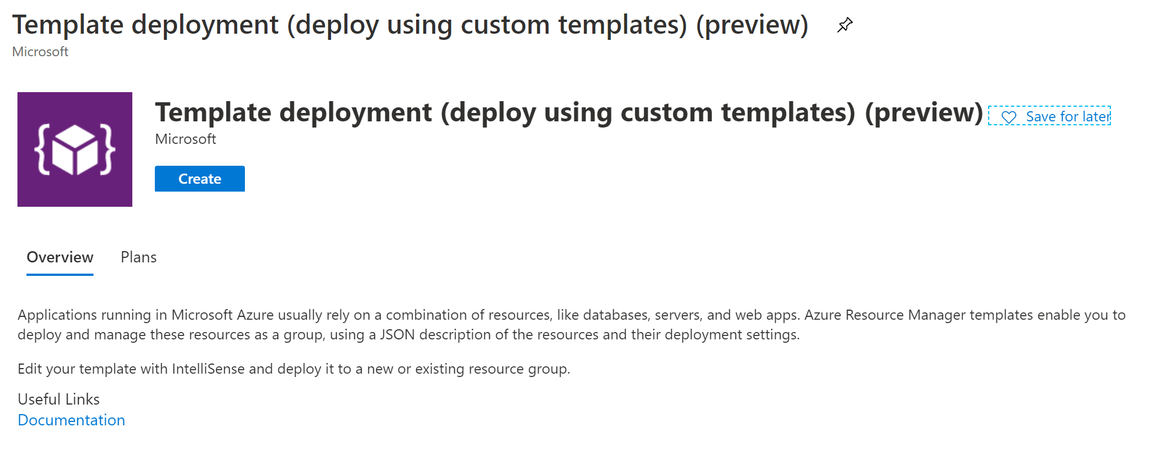
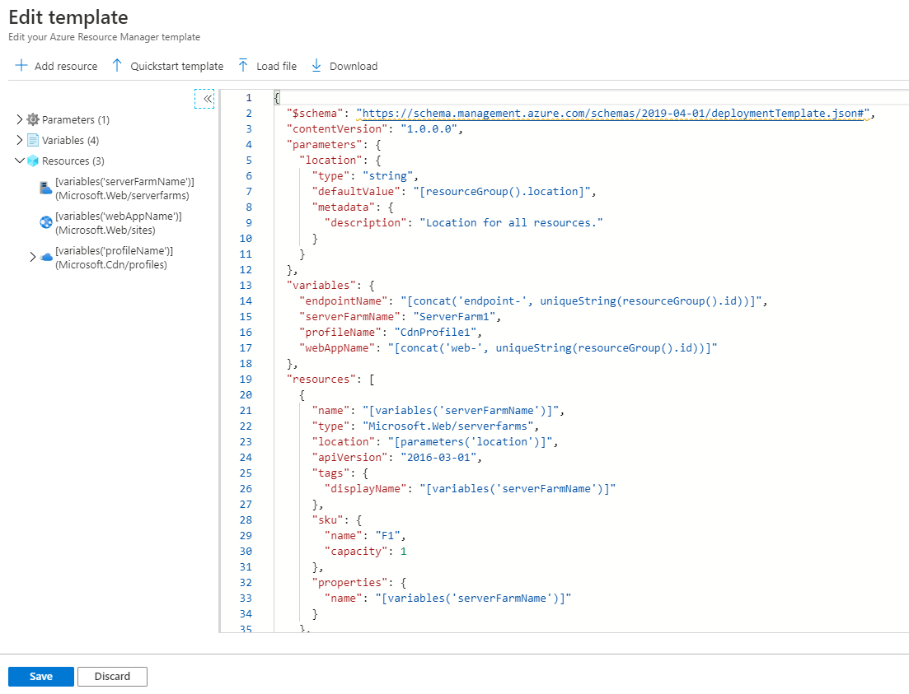
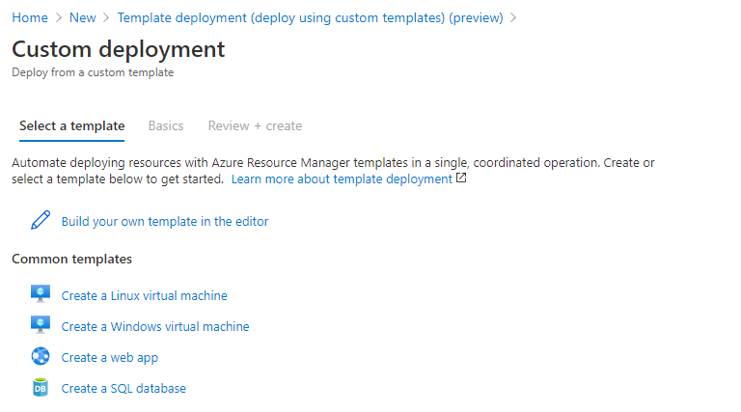
Create a new one (Azure Portal)
Notes:
So here’s the screenshot of how you could create a new ARM template from the Azure Portal.

Slide 9
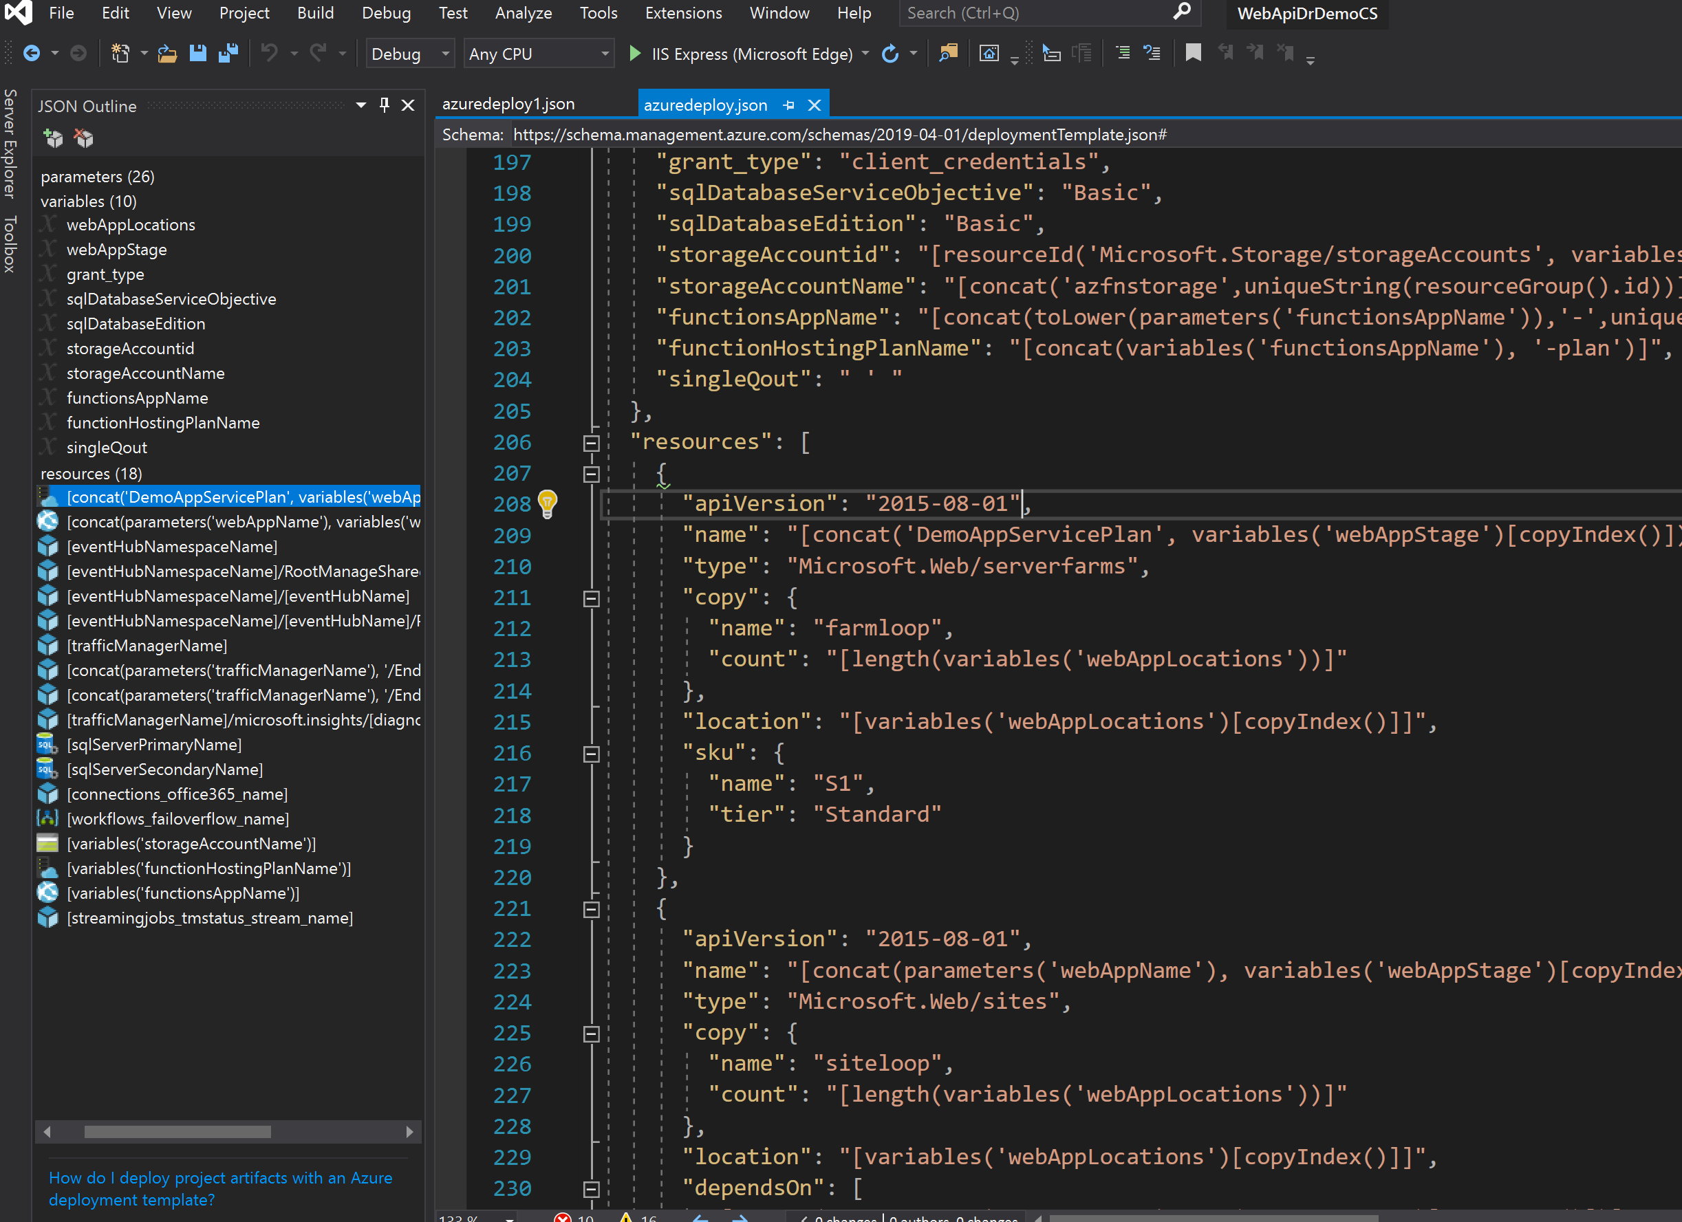
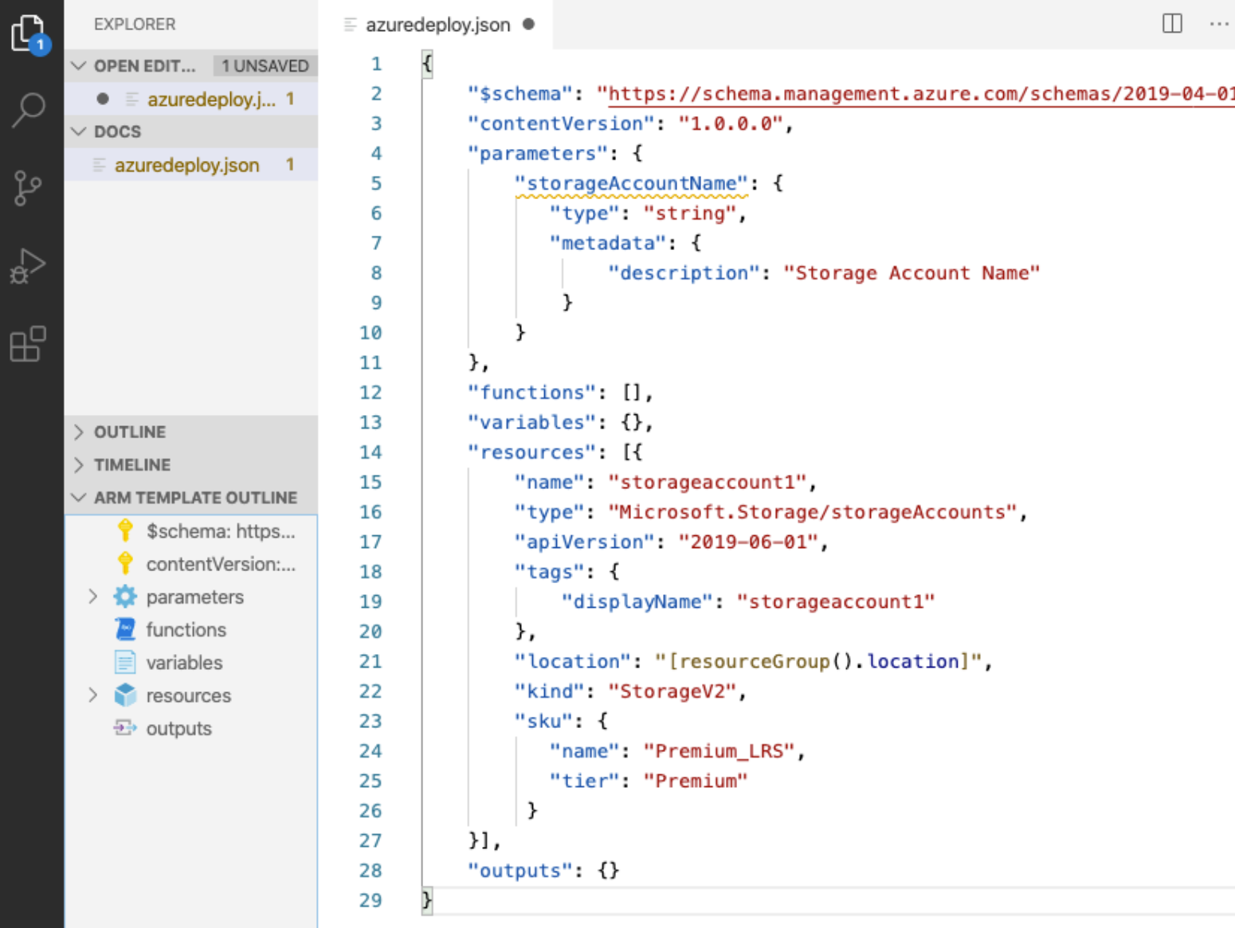
Create a new one (Visual Studio / VS Code)
Notes:
Another alternative is to author the ARM template with Visual Studio or VS Code. Not only it will provide a better editing experience, but also enable you to validate the template.

Slide 10
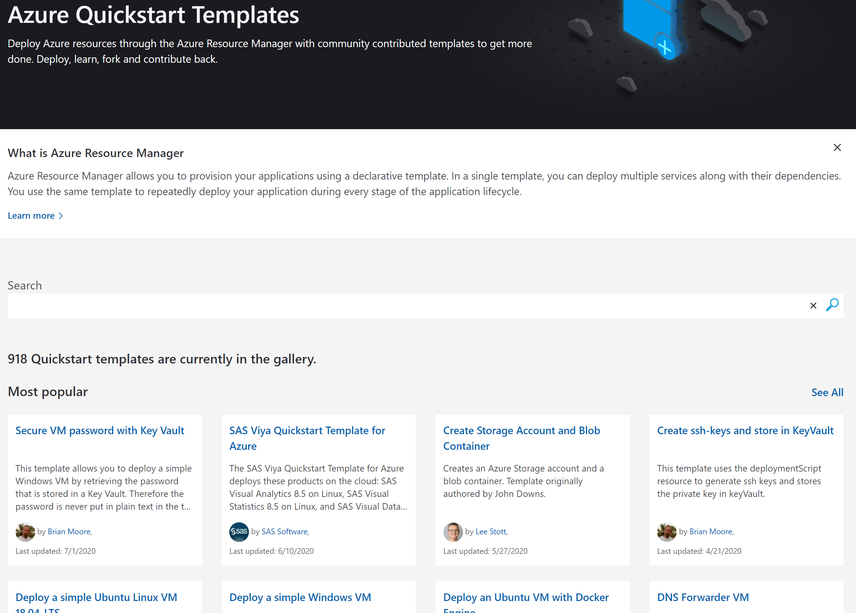
Azure Quickstart Template
https://azure.microsoft.com/en-us/resources/templates/
Notes:
The second option as I mentioned earlier is to leverage on an existing template which are available in resource template. On this link, you can see that we have more than 900 available template for you to choose.
You can pick one and modify according to your need, so that you don’t have to start from scratch.

Slide 11
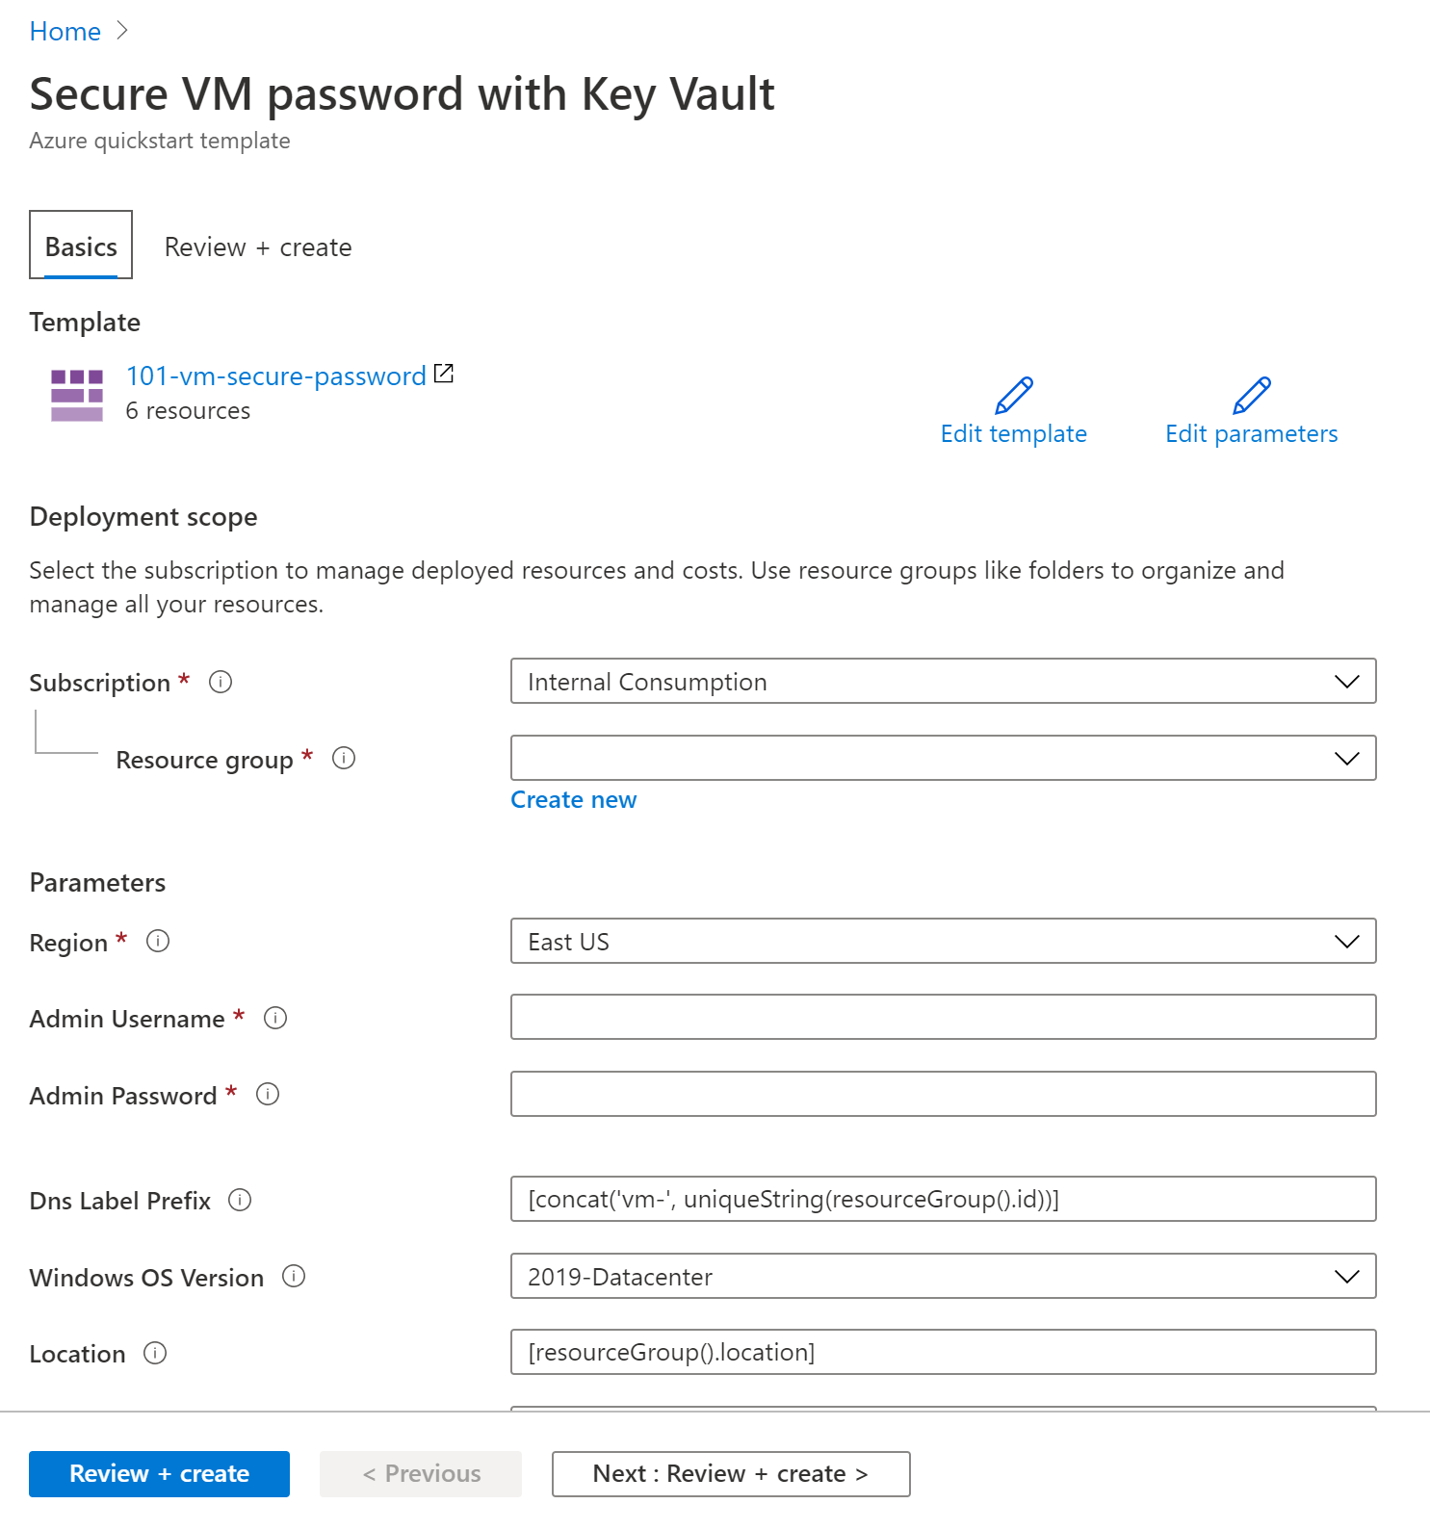
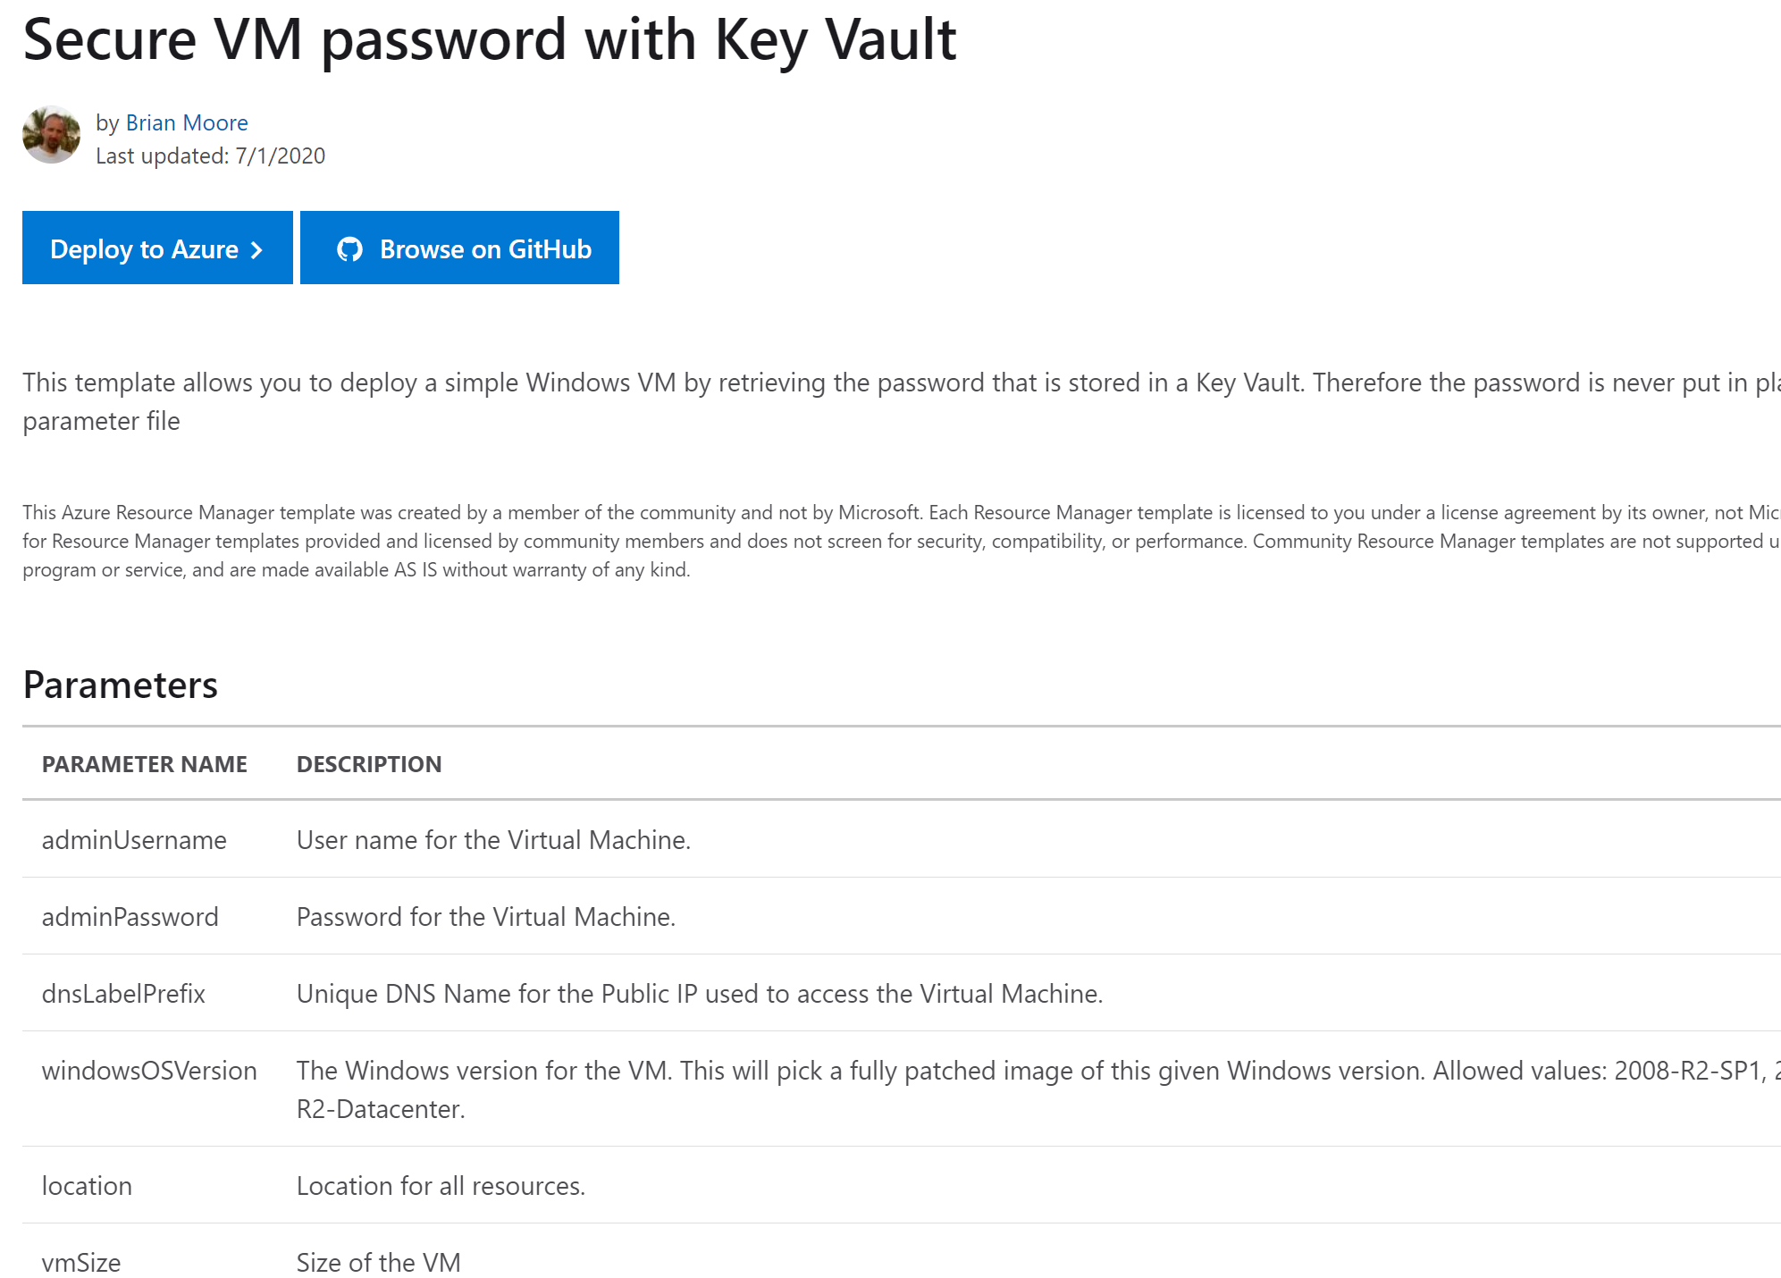
Notes:
Here’s an example of choosing a template from the gallery. You can browse the deployment script in GitHub. And you could also, click the Deploy to Azure button, which feeds in the ARM template as deployment in the Azure portal. You can then fill necessary parameter values and create the deployment.

Slide 12
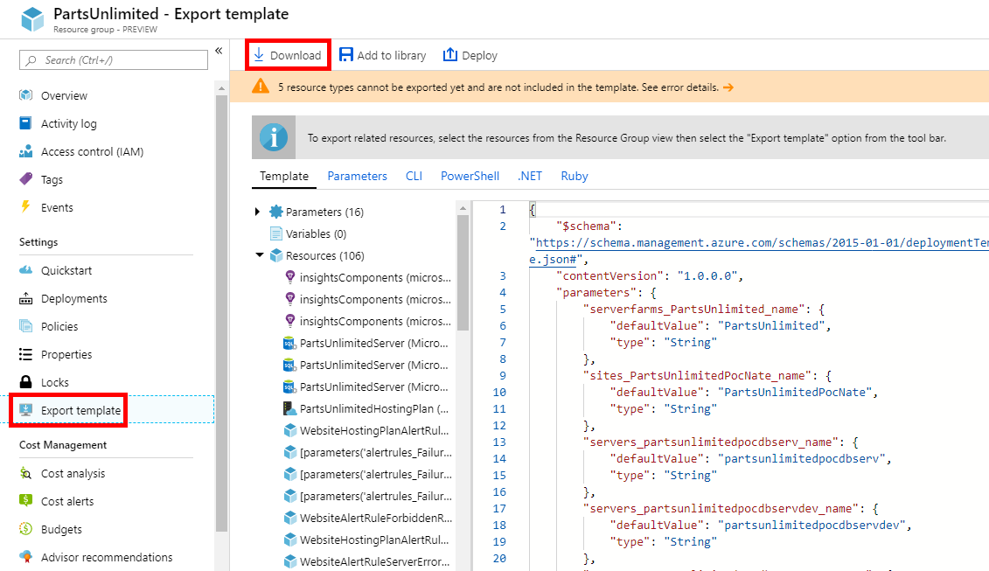
Exporting your Template from Azure Portal
Notes:
Here’s the third option.
Supposed that you already have your Azure resources in a resource group. You can export them by navigate to the Export Template menu in your Resource Group. As you can see that you can, export them as ARM Template or other alternative such as CLI, Powershell, or .NET.

Slide 13
Template functions
You could make use of Template functions when constructing your JSON template:
Array functions: array, concat, contains, empty, first
Comparison functions: coalesce, equals, less, greater
Date functions: dateTimeAdd, utcNow
Deployment value functions: deployment, environment, parameters, variables
Logical functions: and, bool, if, not, or
Numeric functions: add, div, float, int, min, max
Object functions: contains, empty, json, length
Resource functions: listKeys, list, reference, resourceGroup, resourceId
String functions: concat, endsWith, format, length, etc.
Complete list: https://docs.microsoft.com/en-us/azure/azure-resource-manager/templates/template-functions
Notes:
When authoring your ARM template, you would often need to perform a lot of different operations. You could leverage built-in template functions which improve your productivity and efficiency in authoring your template.
We have functions such as array functions, date function, and so many more which you can check out from that link.

Slide 14
Tips and Tricks
Notes:
Ok, now let’s talk about some of the tips and tricks which may help you when dealing with the ARM template.

Slide 15
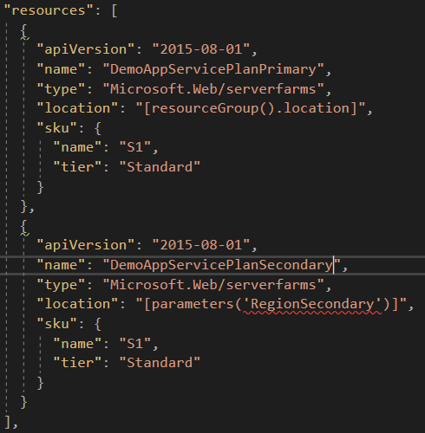
Requirement: create multiple similar resources
Desired outcome:
DemoAppServicePlanPrimary server farm (App Service Plan) deployed in Primary Region (resource group location)
DemoAppServicePlanSecondary server farm (App Service Plan) deployed in Secondary Region (parameter)
Challenges:
Static
Repetition “copy-paste”
Notes:
Let’s say you’d like to create 2 App Service plan which deployed in two separate region.
The simplest way to do that is to create 1 resource and then copy-paste to the second one. Well, that’s a big deal if you only need two resources, what about if you need a lot more.
And we all know the copy-paste isn’t the best technique.

Slide 16
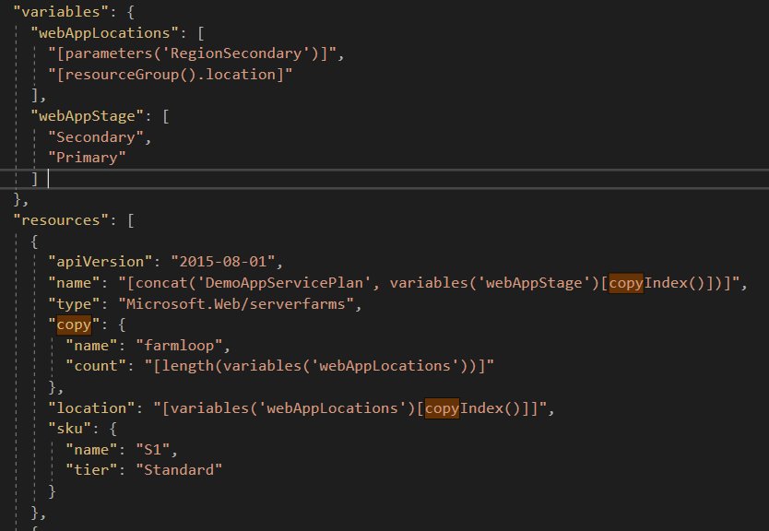
The “copy” and “copyIndex()”
Desired outcome:
DemoAppServicePlanPrimary server farm (App Service Plan) deployed in Primary Region (resource group location)
DemoAppServicePlanSecondary server farm (App Service Plan) deployed in Secondary Region (parameter)
Declarative foreach-like loop
Benefits:
Flexible
Avoid repetition
Notes:
So a better way to do is to define them as variables.
Then you make use of the copy element which implicitly perform a loop over the variable which you’ve defined. In this example, we’ll perform 2 times of loop since the length of the webAppLocations variable is 2.
The copy element is often used together with copyIndex() function which indicate the index of the loop. So as you can see that we’re getting the value of webAppStage.

Slide 17
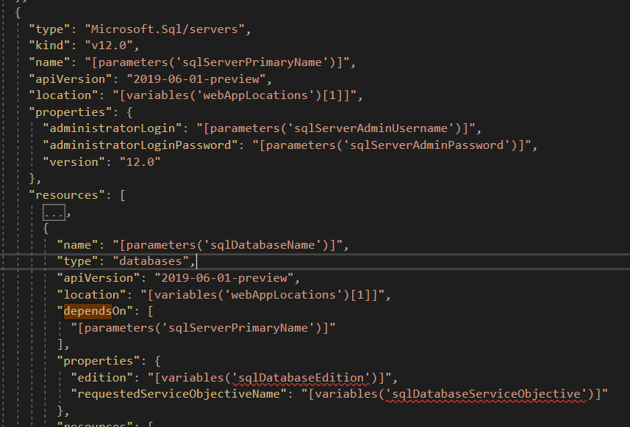
DependsOn
By default, resources defined in ARM template are deployed in parallel.
Benefit: faster deployment
You can make use of DependsOn element to define the dependencies of the resources.
Example: SQL Server will need to be created before SQL Database
Notes:
Another technique that is very useful in ARM deployment is the element of dependsOn.
It’s very often where you need to define the order of resources creation because one needs to be created before another.
For example, we need to create the SQL Server first before the SQL Database. As such, we define the SQL Server in the dependsOn element within the SQL database resource template.

Slide 18
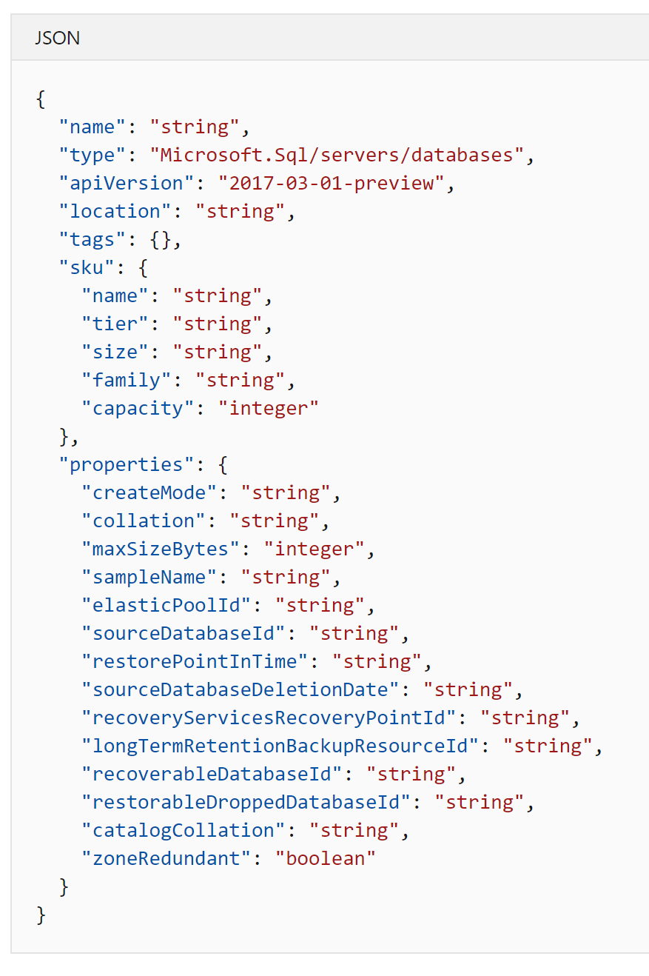
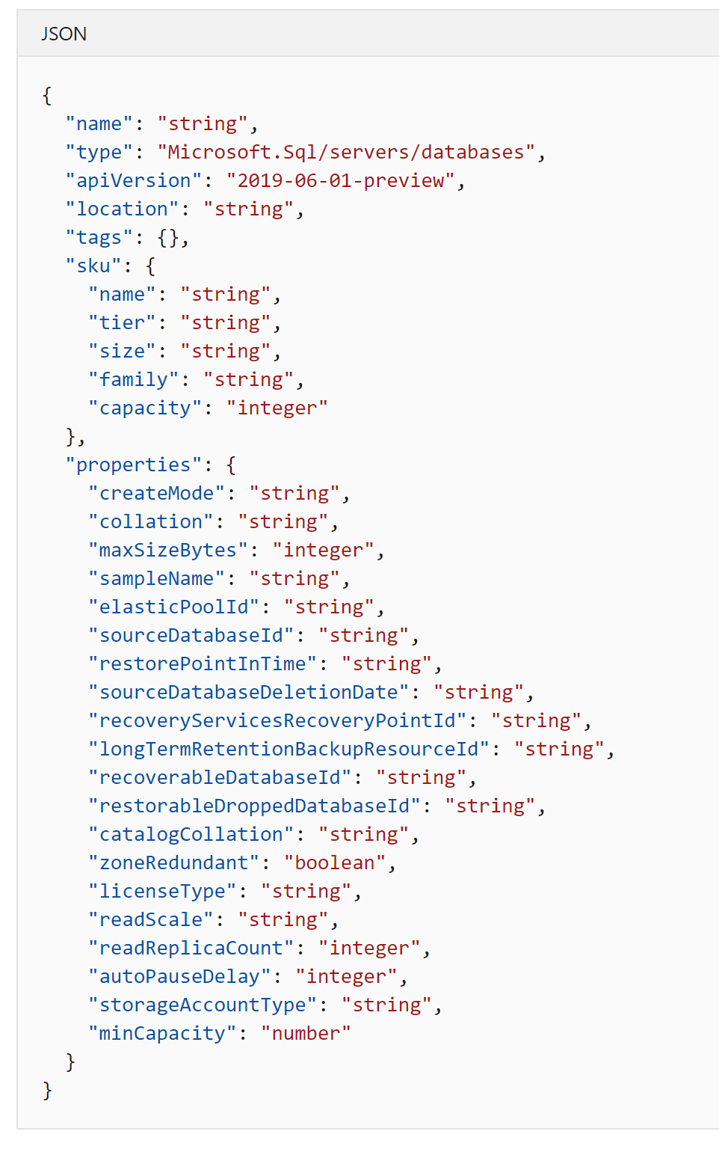
Be extra careful with apiVersion in each Resource Providers
Different apiVersion contains different properties
Details:
https://docs.microsoft.com/en-us/azure/templates/
Notes:
One last tip, be extra careful with the apiVersion when you define your ARM resources.
Generally, the later apiVersion will introduce new properties. So make sure to correlate the apiVersion with the properties appropriately since they are very sensitive.

Slide 19
End of this video
Notes:
Thanks all for this crash course video. I hope you find it useful.
I will see you in the next one, which I will show you how we deploy our solution with the single click ARM template.

